Slide 1
Hope and Recovery: Understanding Substance Use Disorders and the Vocational Rehabilitation Process
By Jonathan D. Sanders MS, CRC, LPC

Slide 2
What to expect?
Brief overview of Substance Use Disorders (SUDs)
We will primarily focus on Alcohol and Opioids
DSM Definitions of SUDs
Statistics
Stigma
Resources
Stories of Hope

Slide 3
What is a substance use disorder (sud)?
According to the DMS 5, a Substance Use Disorder involves patterns of symptoms caused by using a substance that an individual continues taking despite its negative effects. Based on decades of research, DSM-5 points out 11 criteria that can arise from substance misuse. These criteria fall under four basic categories — impaired control, physical dependence, social problems and risky use:

Slide 4
Using more of a substance than intended or using it for longer than you’re meant to.
Trying to cut down or stop using the substance but being unable to.
Experiencing intense cravings or urges to use the substance.
Needing more of the substance to get the desired effect — also called tolerance.
Developing withdrawal symptoms when not using the substance.
Spending more time getting and using drugs and recovering from substance use.
Neglecting responsibilities at home, work or school because of substance use.
Continuing to use even when it causes relationship problems.
Giving up important or desirable social and recreational activities due to substance use.
Using substances in risky settings that put you in danger.
Continuing to use despite the substance causing problems to your physical and mental health.

Slide 5
King alcohol

Slide 8
People Ages 12 and Older
According to the 2023 National Survey on Drug Use and Health (NSDUH), 224.3 million people ages 12 and older (79.1% in this age group) reported that they drank alcohol at some point in their lifetime.^{1,2} This includes:
111.1 million males ages 12 and older (80.1% in this age group)^{1,2}
113.2 million females ages 12 and older (78.1% in this age group)^{1,2}
890,000 American Indian or Alaska Native people ages 12 and older (66.5% in this age group)^{1,2}
10.9 million Asian people ages 12 and older (62.2% in this age group)^{1,2}
24.5 million Black or African American people ages 12 and older (70.5% in this age group)^{1,2}
144.3 million White people ages 12 and older (84.7% in this age group)^{1,2}
4.9 million people of two or more races ages 12 and older (79.8% in this age group)^{1,2}
37.9 million Hispanic or Latino people ages 12 and older (72.6% in this age group)^{1,2}
Estimates for Native Hawaiian or other Pacific Islander people ages 12 and older were not presented because they were based on a relatively small number of respondents or had a large margin of error.^{1,2}

Slide 9
Youth Ages 12 to 17
According to the 2023 NSDUH, 5.6 million youth ages 12 to 17 (21.6% in this age group) reported that they drank alcohol at some point in their lifetime.^{1,2} This includes:
2.5 million boys ages 12 to 17 (19.1% in this age group)^{1,2}
3.1 million girls ages 12 to 17 (24.1% in this age group)^{1,2}
44,000 American Indian or Alaska Native people ages 12 to 17 (18.5% in this age group)^{1,2}
175,000 Asian youth ages 12 to 17 (12.0% in this age group)^{1,2}
541,000 Black or African American youth ages 12 to 17 (15.1% in this age group)^{1,2}
3.1 million White youth ages 12 to 17 (24.0% in this age group)^{1,2}
220,000 youth of two or more races ages 12 to 17 (23.7% in this age group)^{1,2}
1.5 million Hispanic or Latino youth ages 12 to 17 (22.4% in this age group)^{1,2}
Estimates for Native Hawaiian or other Pacific Islander youth ages 12 to 17 were not presented because they were based on a relatively small number of respondents or had a large margin of error.^{1,2}

Slide 10
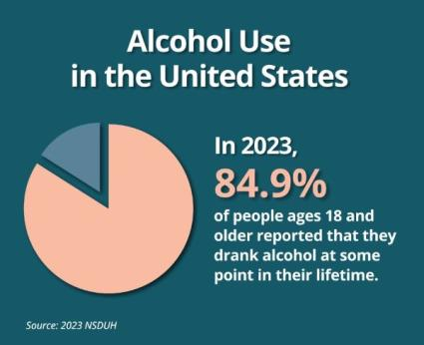
Adults Ages 18 and Older According to the 2023 NSDUH, 218.7 million adults ages 18 and older (84.9% in this age group) reported that they drank alcohol at some point in their lifetime.^{1,2} This includes: 108.6 million men ages 18 and older (86.6% in this age group)^{1,2} 110.1 million women ages 18 and older (83.3% in this age group)^{1,2} 847,000 American Indian or Alaska Native adults ages 18 and older (76.7% in this age group)^{1,2} 10.7 million Asian adults ages 18 and older (66.8% in this age group)^{1,2} 24.0 million Black or African American adults ages 18 and older (76.9% in this age group)^{1,2} 141.3 million White adults ages 18 and older (89.7% in this age group)^{1,2} 4.7 million adults of two or more races ages 18 and older (89.6% in this age group)^{1,2} 36.4 million Hispanic or Latino adults ages 18 and older (80.1% in this age group)^{1,2} Estimates for Native Hawaiian or other Pacific Islander adults ages 18 and older were not presented because they were based on a relatively small number of respondents or had a large margin of error.^{1,2}

Slide 11
opioids
What are they?
Opioids are a class of natural, semi-synthetic, and synthetic drugs that include both prescription medications and illegal drugs like heroin. Prescription medications such as oxycodone (OxyContin®), hydrocodone (Vicodin®), morphine, codeine, fentanyl, and others are mainly used for the treatment of pain. They can also help treat cough or diarrhea. However, like illegal opioids, prescription opioids can be addictive, particularly if they are misused.
Natural opioids, such as morphine, codeine, opium, and thebaine are made from the seed pods of the opium poppy plant. These natural substances are also known as opiates.
Semi-synthetic opioids, such as heroin and the pain relievers oxycodone, hydrocodone, and oxymorphone, are made in laboratories by chemically processing natural opioids.
Synthetic opioids, such as fentanyl are manufactured entirely in laboratories, with no natural ingredients.¹
Opioids differ in their strength, or potency. For example, fentanyl is 50 to 100 times more potent than morphine.² This means that even small doses of fentanyl can be fatal. Fentanyl can be even more dangerous when it is mixed with other drugs. This can happen without the knowledge of the person taking them.³

Slide 12
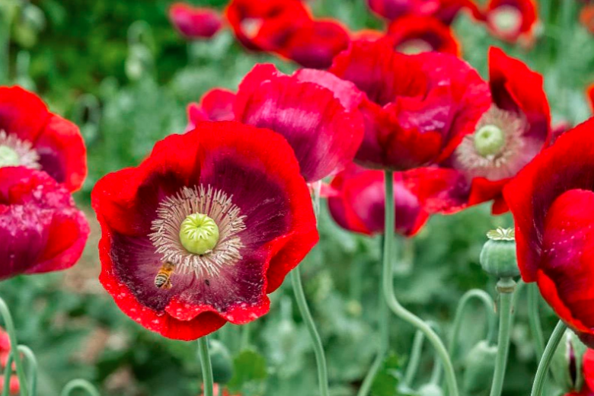

Slide 13
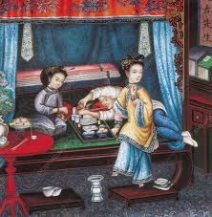
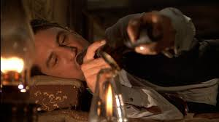

Slide 14
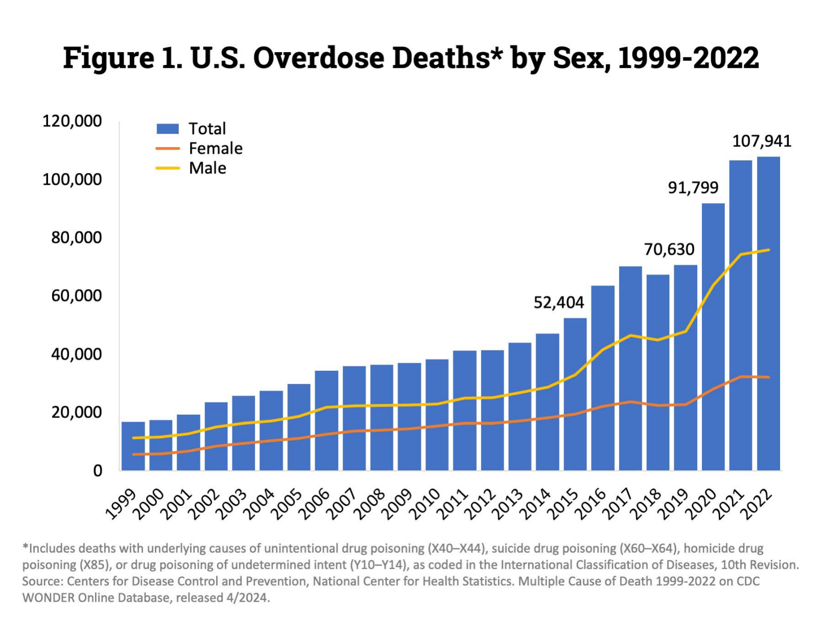
Opioids
In 2022, nearly 110,000 Americans died from drug overdoses. More than 81,000 of these deaths involved either prescription or illicit opioids and increase of approximately 400 percent over a decade. The vast majority, nearly 74,000, of these deaths involved the synthetic opioid fentanyl.

Slide 17
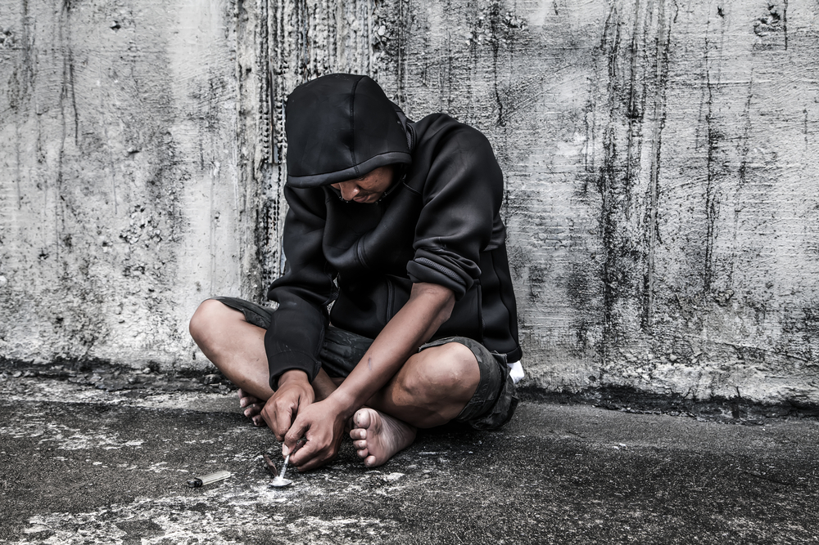
So – what do people look like?

Slide 19
No one starts out this way

Slide 20
How does it begin??
Peer Pressure?
Boredom?
Childhood Trauma?
Curiosity?
Escapism?
What else?

Slide 21
From the mayo clinic…
Genetic, psychological, social and environmental factors can impact how drinking alcohol affects your body and behavior. Theories suggest that for certain people drinking has a different and stronger impact that can lead to alcohol use disorder.
Over time, drinking too much alcohol may change the normal function of the areas of your brain associated with the experience of pleasure, judgment and the ability to exercise control over your behavior. This may result in craving alcohol to try to restore good feelings or reduce negative ones.

Slide 22
There is hope
There are a multitude of treatment programs.
Residential
Long-term and Short-term facilities
Detox
In-patient and partial day programs
Anonymous Programs (12-Step Programs)
Celebrate Recovery
MAT

Slide 23
Employment services
Vocational Rehabilitation Services
IPS

Slide 24
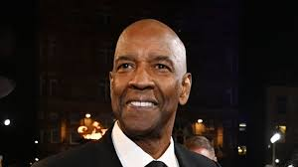
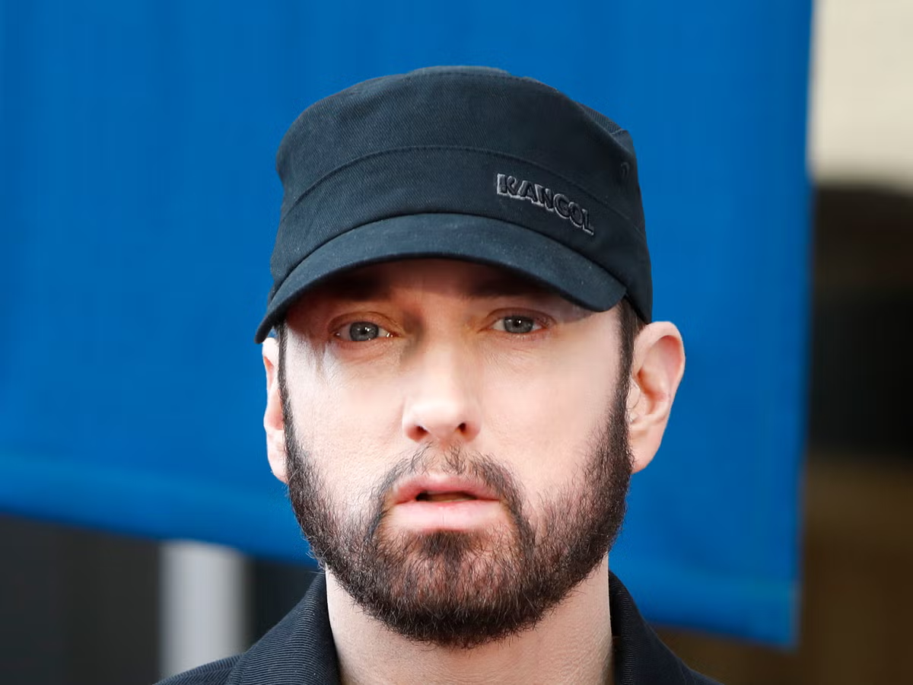
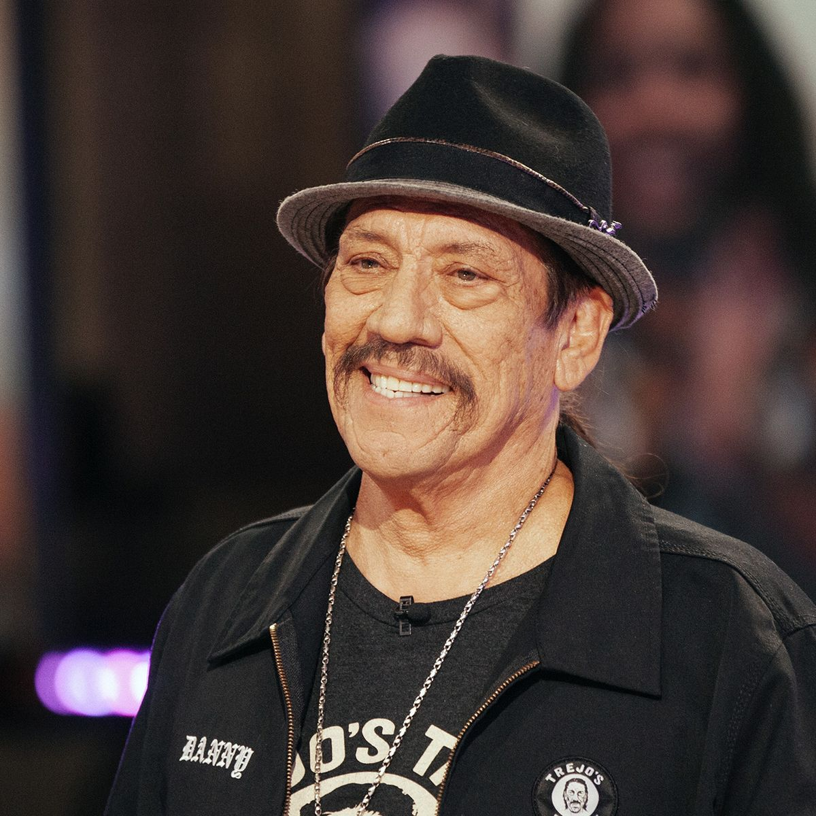
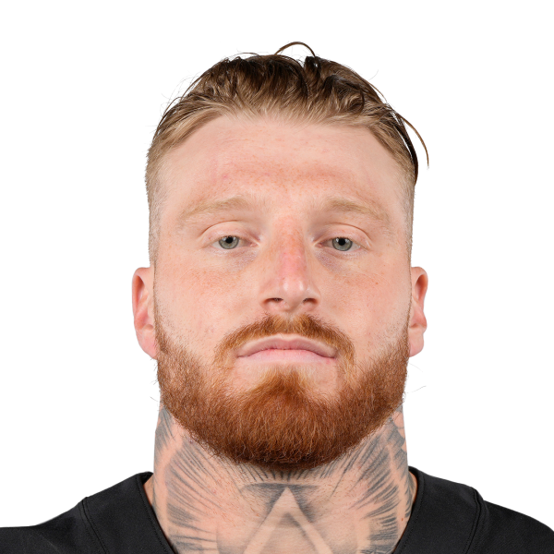
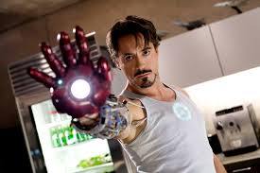
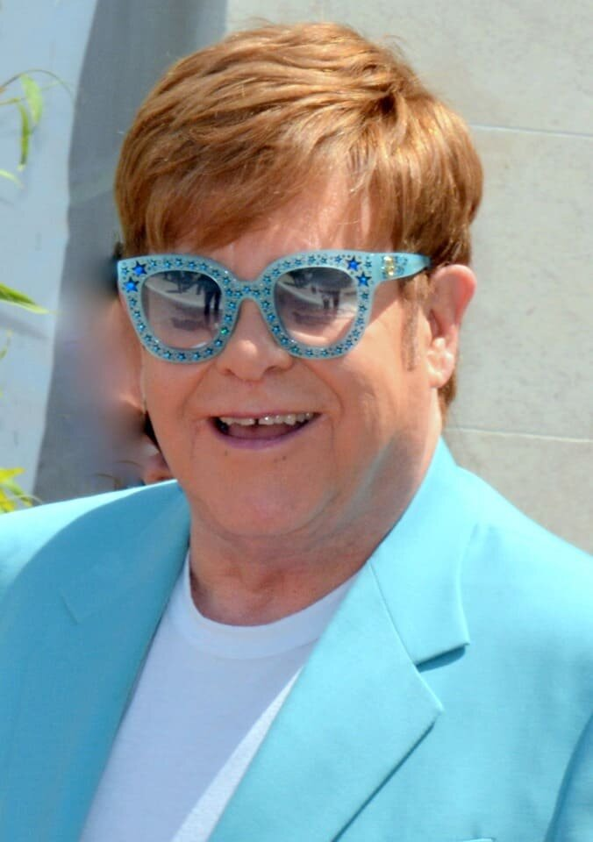
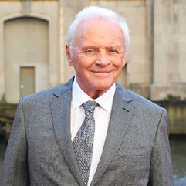
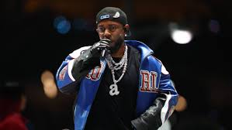
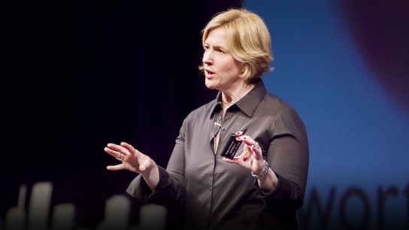
So – who’s sober?

Slide 25
What about everyday people??

Slide 26
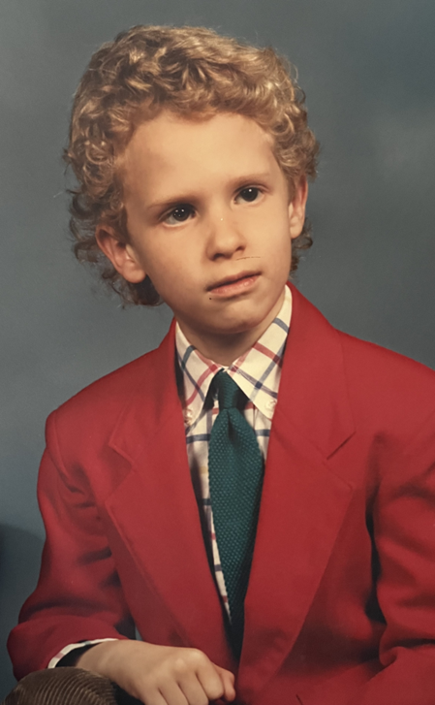
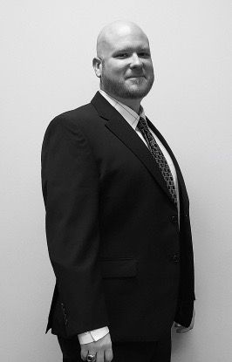
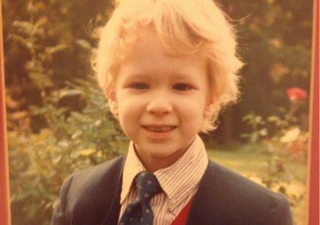

Slide 28
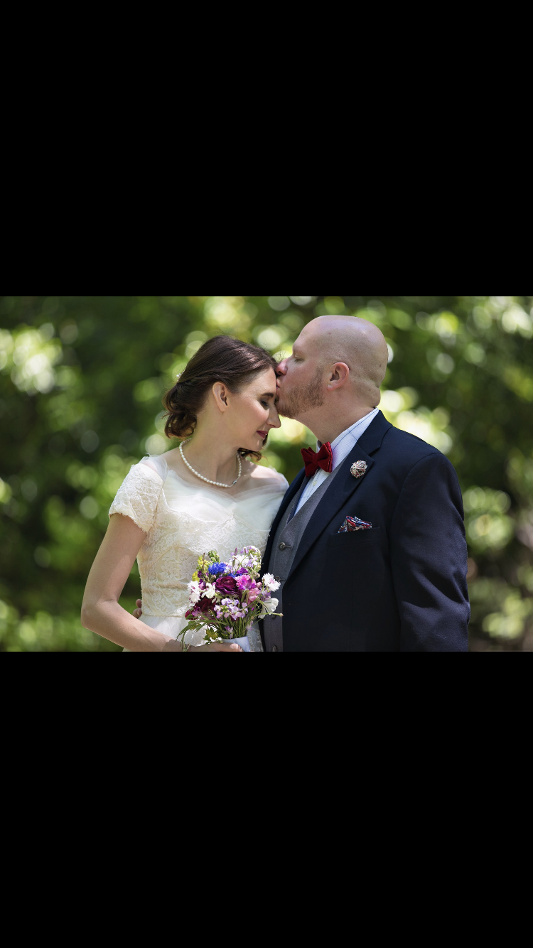

Slide 29
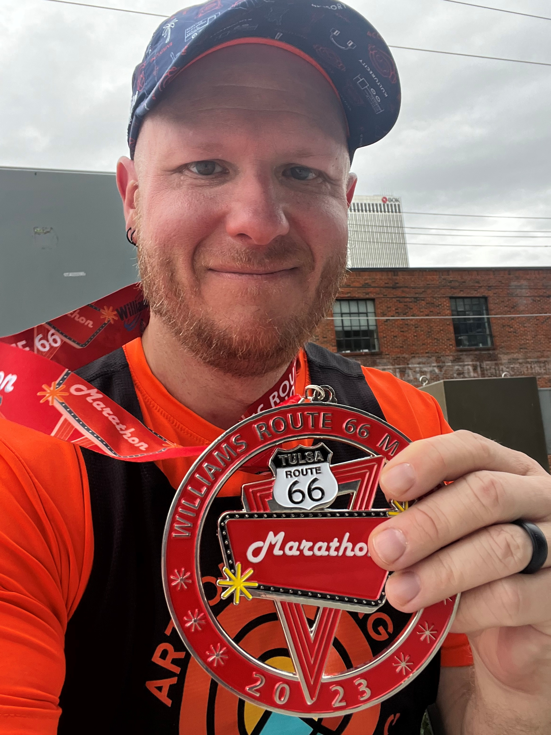

Slide 31
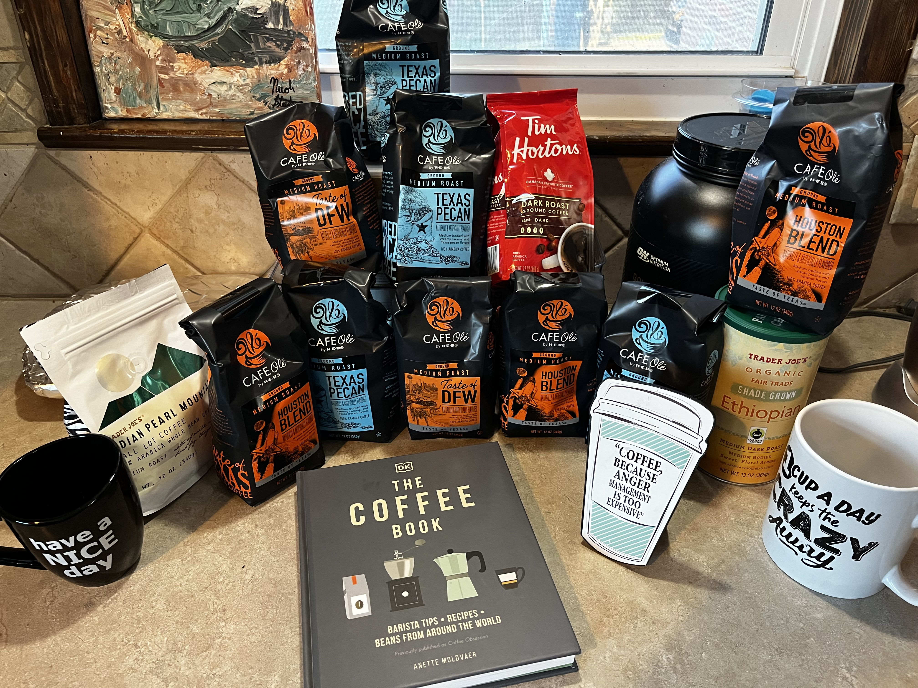

Slide 32
In closing…remember
Be kind; everyone struggles
No matter where you are and no matter what you’ve done, you are loved
There is HOPE
Keep this in mind – you’ve been 100% successful at surviving your worst day
Going from Surviving to Thriving starts one day at a time
The sun will rise tomorrow and with tomorrow brings new opportunities

Slide 33
Reference list
https://www.gatewayfoundation.org/blog/dsm-5-substance-use-disorder/
https://www.niaaa.nih.gov/alcohols-effects-health/alcohol-topics-z/alcohol-facts-and-statistics/alcohol-related-emergencies-and-deaths-united-states
https://www.niaaa.nih.gov/alcohols-effects-health/alcohol-topics-z/alcohol-facts-and-statistics/alcohol-use-united-states-age-groups-and-demographic-characteristics#:~:text=According%20to%20the%202023%20NSDUH%2C%20177.3%20million%20people%20ages%2012,drank%20in%20the%20past%20year.&text=3%2C4-,This%20includes%3A,63.9%25%20in%20this%20age%20group)&text=88.7%20million%20females%20ages%2012,61.2%25%20in%20this%20age%20group)
https://nida.nih.gov/research-topics/opioids#opioids
https://www.wikiwand.com/en/articles/United_States_drug_overdose_death_rates_and_totals_over_time
https://subscribe.heraldtribune.com/restricted?return=https%3A%2F%2Fwww.heraldtribune.com%2Fstory%2Fnews%2F2022%2F02%2F21%2Ffentanyl-and-opioid-crisis-manatee-sees-most-overdose-deaths-since-2016%2F6751032001%2F&gps-source=CPROADBLOCKDH&itm_source=roadblock&itm_medium=onsite&itm_campaign=premiumroadblock&gca-cat=p&gca-uir=true&gca-epti=z119069e008800v119069b00xxxxd11xx65&gca-ft=170&gca-ds=sophi
https://www.mayoclinic.org/diseases-conditions/alcohol-use-disorder/symptoms-causes/syc-20369243

Slide 34
Thank you!
Jonathan D. Sanders MS, CRC, LPC
Jonathan.sanders@rehab.alabama.gov
205-290-4482 (o)
205-908-3161 ©
Senior Rehabilitation Counselor
236 Goodwin Crest Drive
Homewood, AL 35209

